Slide 1
Definitions and Diagnosis
Schizophrenia

Slide 2
Definitions

Slide 3
Schizophrenia: a definition
Schizophrenia is characterized by distortions in thinking, perception, emotions, language, sense of self and behaviour. Common experiences include hearing voices and delusions.
Worldwide, schizophrenia is associated with considerable disability and may affect educational and occupational performance.
People with schizophrenia are 2-2.5 times more likely to die early than the general population. This is often due to physical illnesses, such as cardiovascular, metabolic and infectious diseases.
Stigma, discrimination and violation of human rights of people with schizophrenia is common.
Schizophrenia is treatable. Treatment with medicines and psychosocial support is effective.
Schizophrenia. Factsheet no. 397. Availanle at: http://www.who.int/mediacentre/factsheets/fs397/en/

Slide 4
Schizophrenia: a definition (cont’d)
Common experiences include:
Delusions: fixed beliefs that are not amenable to change in light of conflicting evidence
Themes: persecutory, referential, somatic, religious, grandiose, Erotomanic and nihilistic delusions
Bizarre delusions are clearly implausible and not understandable to same culture peers and do not derive from ordinary life experiences
Thought insertion, thought withdrawal, delusions of control are considered bizarre delusions
Hallucinations: perception like experiences that occur without an external stimuli
Vivid and clear, with the full force and impact of normal perceptions, and not under voluntary control
Occur in clear sensorium
Auditory hallucinations are experienced as voices heard distinct from one’s thoughts
Disorganized thinking (speech)
Formal thought disorder includes derailment or loose associations, tangentiality, incoherence or word salad
Grossly disorganized or abnormal motor behavior (including catatonia)
Problems in goal directed behavior
Catatonia
Negative symptoms
Decreased emotional expression includes reductions in expressions in the face, eye contact, intonation of speech (prosody), and movements of the hand, head and face that give an emotional emphasis to the speech
Avolition is decrease in motivated self-initiated purposeful activities
Others: include anhedonia, asociality and alogia

Slide 5
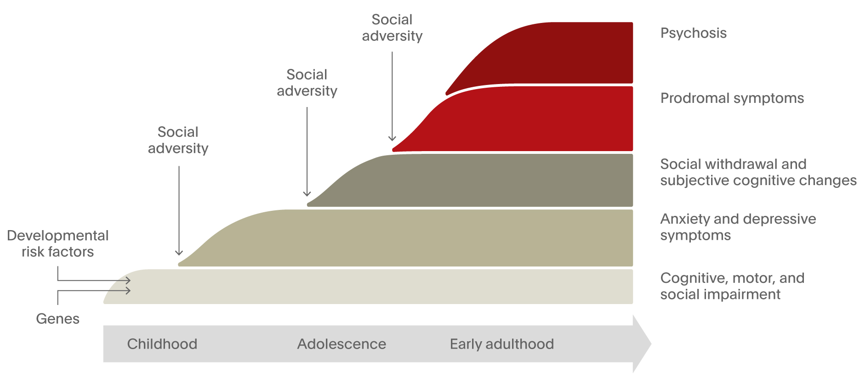
The trajectory to schizophrenia – evolution of symptoms and main risk factors
Adapted Howes & Murray. Lancet 2014;383(9929):1677–1687

Slide 6
Negative Symptoms: something “missing”
Affective blunting: inability to understand and express emotions
Alogia: decrease in verbal communication e.g. poverty of speech, blocking
Anhedonia: loss of ability to find pleasure from relationships/ activities
Avolition: loss of will or drive e.g. hygiene, school
Social withdrawal

Slide 7
Positive Symptoms: Hallucinations
Auditory hallucinations:
discussing, arguing or commentating voices, quite commonly threats and accusations;
also noises such as footsteps
Olfactory, gustatory and tactile hallucinations
Visual hallucinations are more uncommon:
objects, people, fantastic creatures, animals, religious images
in color or black and white

Slide 8
Delusions
Delusions
Firmly held beliefs
Contrary to reality
Resistant to disconfirming evidence
Persecutory delusions common
“The CIA planted a listening device in my head”
Other common forms
Thought insertion
Thought broadcasting
Grandiose delusions
Ideas of reference

Slide 9
What is optimal functioning for a patient with schizophrenia?

Slide 10
Take home points
Functioning is complex and multifactorial, and a variety of factors contribute to functional impairment in patients with schizophrenia
Symptoms that are not fully controlled are significantly associated with impaired global functioning
Current treatment guidelines include optimizing functioning and quality of life as important treatment goals

Slide 11
Functioning is complex and multifactorial
Social
Cognitive
Function in societal roles such as homemaker, worker, student, spouse, family member or friend¹
Working memory, verbal learning and memory, verbal fluency, executive functions, attention²
Vocational
Studied domains of functioning
Community
At least half-time competitive employment or educational involvement⁶
Social competence and behavior, independent living skills, overall adjustment to community living³
Everyday
Psychological
Capacity to perform (or the actual performance of) daily tasks that are essential for maintenance of social and occupational roles⁵
Ability to achieve goals within self and the external environment. Includes an individual's behavior, emotion, social skills and overall mental health⁴
1. Brissos S, et al. Ann Gen Psychiatry. 2011;24;10:18. 2. Bowie CR, Harvey PD . Neuropsychiatr Dis Treat. 2006;2(4):531–536. 3. Dickinson D, Coursey RD. Schizophr Res. 2002;56(1-2):161–70. 4. Preedy, Victor R. Handbook of Disease Burdens and Quality of Life Measures. New York: Springer, 2010. 5. Harvey PD. Cognitive Impairment in Schizophrenia. Cambridge: Cambridge University Press, 2013. 6. Liberman RP, et al. Int Rev Psychiatry. 2002;14(4):256–272.
Notes:
Please note, this slide builds.
Key message: Functioning is complex and multifactorial, and there are many different domains of function e.g. social, everyday, community and psychological functioning, some which are defined on this slide.
Background
Definitions of the various types of functioning have been taken from a variety of different sources, as listed in the references. Additional details:
Social functioning: has been defined globally as the capacity of a person to function in different societal roles such as homemaker, worker, student, spouse, family member or friend. The definition also takes account of an individual’s satisfaction with their ability to meet these roles, to take care of themselves, and the extent of their leisure and recreational activities
Cognitive functioning: cognitive dysfunction is a core feature of schizophrenia. Deficits are moderate to severe across several domains, including attention, working memory, verbal learning and memory and executive functions
Community functioning: the MCAS (Multnomah Community Abilities Scale) is a 17-item community functioning scale that addresses social competence, behavioral problems, independent living skills and overall adjustment to community living
Vocational functioning: successful employment for at least half time in a job in the competitive sector or successful attendance in a school for at least half time for two consecutive years. If of retirement age, participating actively in recreational, family or volunteer activities
References
Brissos S, et al. Ann Gen Psychiatry. 2011;24;10:18.
Bowie CR, Harvey PD . Neuropsychiatr Dis Treat. 2006;2(4):531–536.
Dickinson D, Coursey RD. Schizophr Res. 2002;56(1-2):161–70.
Preedy, Victor R. Handbook of Disease Burdens and Quality of Life Measures. New York: Springer, 2010.
Harvey PD. Cognitive Impairment in Schizophrenia. Cambridge: Cambridge University Press , 2013.
Liberman RP, et al. Int Rev Psychiatry. 2002;14(4):256–272.

Slide 12
A variety of factors contribute to functional impairment in patients with schizophrenia
Symptoms (including depression)
Functional capacity
Medication side effects
Everyday functional disability
Demographic factors
Health status
Social cognition
Cognitive performance
Environmental factors
Figure adapted from Harvey & Strassnig (2012)
Harvey PD, Strassnig M. World Psychiatry. 2012;11:73–79.
Notes:
Please note, this slide builds.
Key message: A variety of factors contribute to impairment in everyday functioning in patients with schizophrenia, including functional capacity, social cognition, symptoms, environmental factors, and health status.
The figure on this slide shows a theoretical summary of the multiple potential influences on everyday functional disability identified across multiple research studies in people with schizophrenia.
Background
Impaired everyday functioning is a complex phenomenon, because many factors contribute to adequate outcomes. These factors include:
The ability to perform functional skills
The motivation to perform the skills
Recognition of the situations where skilled performance is likely to be successful
Factors that interfere with ability, motivation, and the situation recognition required to optimize skills performance
These interfering factors include symptoms, health status (i.e. the status of physical health), and medication side effects.
Further, there are environmental factors that directly and indirectly influence functioning in the real-world.
Reference
Harvey PD, Strassnig M. World Psychiatry 2012;11:73–79.

Slide 13
Multiple measures of patient functioning exist, but may not always help to understand the impact on the patient¹
Scale | What is measured? | How is it administered? | No. of items | Item scoring | Total score range
Global Assessment of Functioning (GAF) Scale² | Social, occupational and psychological functioning | Clinician-rated | 3 | Clinical judgement | 0–100
Personal and Social Performance scale (PSP)³ | Personal and social dysfunction (socially useful activities, personal and social relationships, self-care, and disturbing and aggressive behaviors) | Clinician-rated | 4 | 6-point severity scale for behavioral domains and clinical judgement | 1–100
U. of California San Diego Performance-Based Skills Assessment (UPSA)⁴ | Five domains of everyday functioning capacity | Trained lay person (non-clinician) Role-play tasks: Individual performance is measured | 5 | Raw scores assigned relative to task completion, then used to calculate total score | 0–100
This is not an exhaustive list and there are other scales that measure functioning
1. Wilson C, et al. Early Interv Psychiatry. 2016;10(1):81–87. 2. Robertson DA, et al. Schizophr Res. 2013;146(1–3):363–365. 3. Nasrallah H, et al. Psychiatry Res. 2008;161(2):213–224. 4. Patterson TL, et al. Schizophr Bull. 2001;27(2):235–245.
Notes:
Key message: Although many measures of functioning exist, little is known about how these measures help to understand the impact of functional impairment¹
To comprehensively evaluate functional outcome in schizophrenia, a combination of performance-based and other assessment modalities may be required⁵
Background
Global Assessment of Functioning (GAF)²
The GAF is a subjective measure based on a clinician's opinion of a patient's level of functioning and has been found to be a reliable and valid tool
Impairments in psychological, social and occupational/school functioning are considered, but those related to physical or environmental limitations are not
The clinical rated scale ranges from 0 (inadequate information) to 100 (superior functioning)
Personal and Social Performance scale (PSP)³
The PSP was developed through focus groups and reliability studies
27 different areas of personal and social dysfunction were identified by focus groups and these were incorporated into four domains (“socially useful activities”, “personal and social relationships”, “self-care”, and “disturbing and aggressive behaviors”)
PSP provides an overall rating score from 1 to 100, with higher scores representing better personal and social functioning
University of California San Diego Performance-Based Skills Assessment (UPSA)⁴
The UPSA is a performance-based measure of capacity to perform everyday functioning
Patient performance in 5 domains is assessed (Household Chores; Communication; Finance; Transportation; and Planning Recreational Activities)
The total time required to complete the UPSA is ~30 minutes
Total scores for each subscale are calculated by transforming raw scores into a 0–10 scale, yielding comparable scores on each scale. Each score is multiplied by 2 to give a 100-point summary score
References
Wilson C, et al. Early Interv Psychiatry. 2016;10(1):81–7.
Robertson DA, et al. Schizophr Res. 2013;146(1–3):363–5.
Nasrallah H, et al. Psychiatry Res. 2008;161(2):213–24.
Patterson TL, et al. Schizophr Bull. 2001;27(2):235–45.
McKibbin CL, et al. Schizophr Res. 2004;72(1):53–67.

Slide 14
Quality of life can be measured using different scales
Scale | What is measured? | How is it administered? | No. of items | Item scoring | Total score range
Heinrichs–Carpenter Quality of Life Scale (QLS)¹ | Life satisfaction and social and occupational role functioning (intrapsychic foundations, interpersonal relations, instrumental role, common objects and activities) | Clinician-rated Derived from a semi-structured patient interview | 21 | 7-point severity scale | 0–126²
Health-related quality of life among people with schizophrenia (S-QoL)³ | Eight subscales (psychological well-being, self-esteem, family relationships, relationships with friends, resilience, physical well-being, autonomy and sentimental life) and a total score | Self-administered | 41 | 5-point Likert scale | 0–100
This is not an exhaustive list and there are other scales that measure quality of life
1. Bilker WB, et al. Neuropsychopharmacology. 2003;28(4):773–777. 2. Cramer J, et al. Schizophr Bull. 2001;27(2):227–234. 3. Auquier P, et al. Schizophr Res. 2003;63(1–2):137–49.
Notes:
Key message: Quality of life can be measured using different scales
Background
Heinrichs-Carpenter Quality of Life Scale (QLS)^{1,2}
The QLS balances subjective questions regarding life satisfaction and occupational role functioning
It consists of a 21-item scale, with behavioral anchors presented for each item, scored on a 0 (severe impairment) to 6 (high functioning) scale
The four independent theoretical constructs assessed are intrapsychic foundations (measures related to sense of purpose and motivation), interpersonal relations (examining social experience), instrumental role (related to work functioning), common objects and activities (which measures engagement in the community by possession of common objects and participation in a range of activities)
When administered by a trained clinician as a semi-structured interview, the scale provides information on symptoms and functioning during the 4 weeks prior to assessment
Health-related quality of life among people with schizophrenia (S-QoL)³
The S-QoL, based on Calman’s approach to the subject’s point of view, is a multidimensional instrument that is sensitive to change
It consists of a 41-item questionnaire with eight subscales (psychological well-being, self-esteem, family relationships, relationships with friends, resilience, physical well-being, autonomy and sentimental life) and a total score
Each item is scored on a five-point Likert scale, anchored at the ends from 1 (less than expected) to 5 (more than expected). The negatively worded item scores are reversed
All scales are linearly transformed to a 0–100 scale, with 100 indicating the most favourable quality of life, and 0 the least favourable
The S-QoL is administered by subject self-report; it is not intended to replace conventional outcome measures, however, it adds important information to that traditionally collected in psychiatry
References
Bilker WB, et al. Neuropsychopharmacology. 2003;28(4):773–7.
Cramer J, et al. Schizophr Bull. 2001;27(2):227–34.
Auquier P, et al. Schizophr Res. 2003;63(1–2):137–49.

Slide 15
Patients may have functional goals that are personal and meaningful to them
Goals that may be set by patients include:
Have a relationship with family members
Get in shape physically
Take better care of my body
Learn how to talk with people
Sleep better
Have a romantic relationship
Quit smoking or drinking alcohol
Social & family
Physical health
Go back to school
Occupational & financial
Living arrangements
Pay bills on time
Live in a group home
Start a new hobby
Keep my home clean
Find employment
Med IQ. Goal-Setting Worksheet for People with Schizophrenia. Available at: http://www.med-iq.com/files/noncme/material/pdfs/GoalSetting1.pdf; Accessed June 2016.
Notes:
Key message: Goal-setting helps patients focus on improving their daily lives, and accomplishing these goals provides a sense of satisfaction and success (Med-IQ, 2014)
References
Med IQ. Goal-Setting Worksheet for People with Schizophrenia. Available at: http://www.med-iq.com/files/noncme/material/pdfs/GoalSetting1.pdf; Accessed June 2016.

Slide 16
Patients may have functional goals that are personal and meaningful to them
63% of patients with psychosis have obvious or severe dysfunction in socializing²
Have a better relationship with family members
Get in shape physically
Take better care of my body
Learn how to talk with people
32% of patients with psychosis have obvious or severe dysfunction in quality of self care²
Sleep better
Have a romantic relationship
Quit smoking or drinking alcohol
Social & family
Physical health
Better social and occupational functioning are consistently identified as important self-defined treatment goals³
Go back to school
Occupational & financial
Living arrangements
Pay bills on time
Live in a group home
Enhanced functioning may be the most meaningful and valued outcome of treatment for patients and family³
Start a new hobby
Keep my home clean
Find employment
1. Med IQ. Goal-Setting Worksheet for People with Schizophrenia. Available at: http://www.med-iq.com/files/noncme/material/pdfs/GoalSetting1.pdf; Accessed June 2016. 2. Morgan VA, et al. Aust N Z J Psychiatry. 2012;46(8):735−752. 3. Bellack AS, et al. Schizophr Bull. 2007;33(3):805–822.
Notes:
Key message: Better social and occupational functioning are consistently identified as important self-defined treatment goals, and improved functioning may be the most meaningful and valued outcome of treatment from a patient and family perspective³
Background
In an Australian study that combined the findings of two studies of patients with psychosis (the first in 1997–98 [n=687], the second in 2010 [n=1211]), 63.2% were found to have obvious/severe dysfunction in socializing, and 32.3% had obvious or severe dysfunction in quality of self care²
Both the 1997−98 and 2010 surveys had similar aims, employed the same two-phase design and methodology, and used the same core instruments: the ‘Psychosis Screener’ for census month screening and the ‘Diagnostic Interview for Psychosis’ for the interview²
Social dysfunction is one of the most important factors in the disability associated with the illness, and is a source of great distress for patients and family members³
Most patients have significant impairments in social relationships, and are often socially isolated. When they do interact with others, they often have difficulty maintaining appropriate conversations, expressing their needs and feelings, achieving social goals, or developing close relationships³
There is increasing recognition that deficits in functioning in the form of social isolation, unemployment and impaired self-care represent a significant component of illness burden. While symptom control is an important treatment outcome, both patients and families consistently identify better social and occupational functioning as important self-defined treatment goals³
From the patient and family perspective, enhanced functioning may be the most meaningful and valued outcome of treatment. Given the societal costs of poor functioning, it is also a priority for society at large³
References
Med IQ. Goal-Setting Worksheet for People with Schizophrenia. Available at: http://www.med-iq.com/files/noncme/material/pdfs/GoalSetting1.pdf; Last accessed June 2016.
Morgan VA, et al. Aust N Z J Psychiatry. 2012;46(8):735−52.
Bellack AS, et al. Schizophr Bull. 2007;33(3):805–22.

Slide 17
People with schizophrenia experience motivation deficits
People with schizophrenia more often refer to their goals as being driven by boredom or a desire to ‘pass time’
***
Healthy controls (n=41)
People with schizophrenia (n=47)
Motivating factor
*
***
Factors influencing motivation type
Psychological needs
Autonomy
Competence
Relatedness
External forces
Towards praise/reward (positive)
Away from punishment or criticism (negative)
Lack of agency (ie ability to act in any given environment)
Overall disconnect with actions and environment
*P≤0.05 ***P<0.001.
Adapted from Gard DE et al. Schizophr Res. 2014;156(2-3):217–222.
Notes:
Key message: People with schizophrenia more often refer to their goals as being driven by boredom or a desire to ‘pass time’ and report goals that are more disconnected–disengaged compared with those of healthy controls
Patients with schizophrenia also have significantly lower intrinsic motivation and extrinsic positive motivation compared with healthy controls
Background
Agency = ability to act in any given environment
47 people with and 41 people without schizophrenia were provided with cell phones and were called four times a day for one week. During each call participants were asked about their goals, and about the most important reason motivating each goal. Each goal/reason was rated on a scale of specific anchors (0–3).
All responses were coded by independent raters (blinded to group and hypotheses) on all Self-Determination Theory (SDT) motivating factors, and ratings were correlated with patient functioning and symptoms.
Relative to healthy participants, people with schizophrenia reported goals that were:
less motivated by filling autonomy (motivated behavior towards agency and self-expression) and competency (motivated behavior towards knowledge, skill or learning) needs, but equivalently motivated by relatedness (interpersonal connection)
less extrinsically rewarding, but equivalently motivated by punishment
more disconnected–disengaged (the individual feels that their behavior is not connected to an outcome and that he or she lacks agency, choice, or direction)
Higher rates of disconnected–disengaged goals were significantly associated with higher negative symptoms and with impairments in patient functioning
The findings highlight the importance of intervening early and at each level of motivated behavior, with the aim of helping people with schizophrenia avoid over-engagement in disconnected–disengaged behaviors, thereby assisting them to increase their functioning and quality of life.
Reference
Gard DE et al. Schizophr Res. 2014;156(2–3):217–222.

Slide 18
Motivation deficits significantly predict poor functional outcomes in early schizophrenia
Relationship between clinical variables (motivation, neurocognition, social amotivation) and measures of functional status
***
***
***
*
*
*
*
***
***
***
Reported correlations are statistically significant at the *p<0.05, **p<0.01 or ***p<0.001 level. †Spearman’s rank-order correlation coefficients. Study sample size (n) =166.
Fervaha G, et al. Schizophr Res. 2015;166(1–3):9–16.
Notes:
Key message: Motivational deficits are prevalent in patients with schizophrenia, and correlate significantly with each domain of functioning examined (global functional outcome, social functioning, role functioning, and number of days worked in the past 30 days). These deficits are prevalent even in the early stages of the illness, and represent one of the most robust barriers to people with schizophrenia achieving functional recovery¹
Motivation is defined as the energy, direction, persistence, and intentionality that direct biological, cognitive, and psychological functioning²
Social amotivation is comprised of asociality and apathy, and is a core negative symptom of schizophrenia, possibly caused by a disruption in reward functioning, and characterized by reduced ability to anticipate and/or experience pleasure³
Background¹
This study examined the prevalence of motivational deficits in patients early in the illness, and the impact these deficits have on community functioning
166 patients with schizophrenia (aged 18–35 years) and within 5 years of initiating antipsychotic treatment were included. First-episode patients were excluded. Data were collected as part of the Clinical Antipsychotic Trial of Intervention Effectiveness (CATIE) schizophrenia study
The primary measure of interest was the Heinrichs–Carpenter Quality of Life Scale (QLS). Motivation was evaluated using the sum of 3 items from the intrapsychic foundations subscale of the QLS: curiosity, goal-directed motivation and sense of purpose
In the sample of patients with early schizophrenia, 15.1% experienced severe deficits in motivation and 76.5% had some degree of motivational impairment
Changes in motivation were linked to changes in functioning; however, this was not the case for changes in cognitive performance
Motivational deficits are prevalent in patients with schizophrenia and demonstrate a pervasive effect on patient functioning, impacting each domain of functioning examined
A social amotivation score was derived by summing the following items from the Positive and Negative Syndrome Scale (PANSS): emotional withdrawal, passive apathetic withdrawal and active social avoidance
Motivation was evaluated using the sum of 3 items from the intrapsychic foundations subscale of the QLS: curiosity, goal-directed motivation and sense of purpose
Neurocognition was evaluated using a battery of assessments, which were converted into standardized scores and combined to construct five domain scores: verbal memory, vigilance, processing speed, reasoning and problem-solving, and working memory. These were standardized and averaged to create a neurocognitive composite score.
References
Fervaha G, et al. Schizophr Res. 2015;166:9–16.
Sian PC, Tan SH. IPEDR. 2012. (56)89
Horton LE, et al. Schizophr Res. 2014; 159(1): 27–30.

Slide 19
Current treatment guidelines include optimizing functioning and quality of life as important treatment goals
1
Reduce or eliminate symptoms, ensuring symptom remission or control is maintained¹
2
Maximize quality of life and adaptive functioning^{1,2}
Maximise quality of life and adaptive functioning^{1,2}
3
Promote and maintain recovery from the debilitating effects of the illness to the maximum extent possible^{1,2}
4
Monitor for adverse treatment effects¹
5
Prevent relapse from occurring¹
1. Hasan A, et al. World J Biol Psychiatry. 2013;14(1):2–44 [WFSBP guidelines].
2. Lehman AF, et al. [APA Practice Guidelines] 2010.
Notes:
Note, this slide contains builds. Goals 2 and 3 change colour to red as these are the most relevant to the focus of the deck.
Key message: Current treatment guidelines include optimizing functioning and quality of life as important treatment goals, along with symptom control, prevention of relapse and monitoring for adverse events
Background
WFSBP: The main goals of treatment during the stable phase are to ensure that symptom remission or control is sustained, that the patient is maintaining or improving their level of functioning and quality of life, that monitoring for adverse treatment effects continues, and relapse is prevented¹
APA: Because schizophrenia is a chronic illness that influences virtually all aspects of life of affected persons, treatment planning has three goals: 1) reduce or eliminate symptoms, 2) maximize quality of life and adaptive functioning, and 3) promote and maintain recovery from the debilitating effects of illness to the maximum extent possible²
References
Hasan A, et al. World J Biol Psychiatry. 2013;14(1):2–44 [WFSBP guidelines]
Lehman AF, et al. [APA Practice Guidelines] 2010.

Slide 20
Health-related quality of life encompasses many variables
Health-related quality of life is subjective and multidimensional¹
The severity of psychotic symptoms
Health-related quality of life is conceptualized as the subject’s perception of the outcome of an interaction between:²
Premorbid characteristics
Subjective interpretation
Side effects (including subjective responses to antipsychotic drugs)
Level of psychosocial performance
Psychosocial adjustment
1. Cramer JA, et al. Schizophr Bull 2000;26(3):659–666. 2. Awad AG, et al. Qual Life Res 1997;6(1):21–26.
Notes:
Key message: Health-related quality of life is complex and encompasses functional abilities, well-being, social interaction, vocational status, and physical and psychological state
Background¹
Assessment of health-related quality of life (HRQoL) has become an important aspect in the evaluation of treatment programs for people with chronic severe schizophrenia
HRQoL encompasses several major dimensions, including psychological status, functional abilities, subjective wellbeing, social interactions, economic status, vocational status, and physical status
HRQoL in schizophrenia can be assessed by direct patient response or by a rating based on a structured interview
Background²
In the proposed model shown on the slide, the QoL of individuals maintained on antipsychotic drug therapy for schizophrenia is viewed as the patient’s perception of the outcome of an interaction between severity of psychotic outcomes, side-effects (including subjective responses to antipsychotic drugs), and the level of psychotic performance
The validity of the model was tested in a clinical setting with patients with schizophrenia (n=62) who were clinically stabilized on antipsychotic drug therapy
The results of the study broadly endorse the key aspects of the proposed model, and suggest that improvements in patients’ subjective experiences during antipsychotic therapy can enhance patients’ QoL
References
Cramer JA, et al. Schizophr Bull. 2000; 26(3):659–666.
Awad AG, et al. Qual Life Res. 1997;6(1):21–26.

Slide 21
Diagnosis

Slide 22
How to diagnose schizophrenia
No laboratory test available
No disease-specific biomarkers (genetic, imaging, neurophysiology)
Based on psychiatric history and mental state evaluation
Positive diagnosis requires:
clear evidence of psychosis in mental state examination
absence of prominent affective symptoms
minimum duration of illness
exclusion of other disorders that may mimic schizophrenia
medical & neurological diseases
other psychiatric disorders

Slide 23
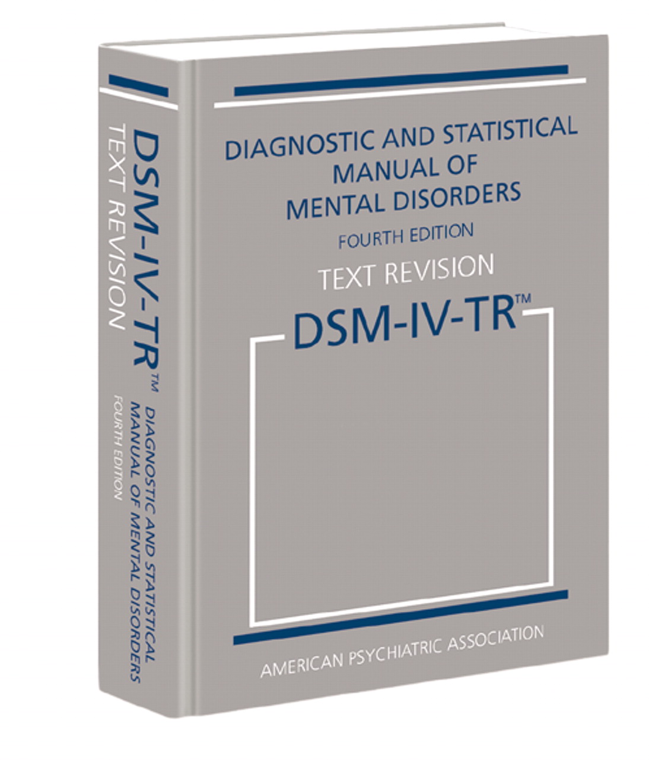
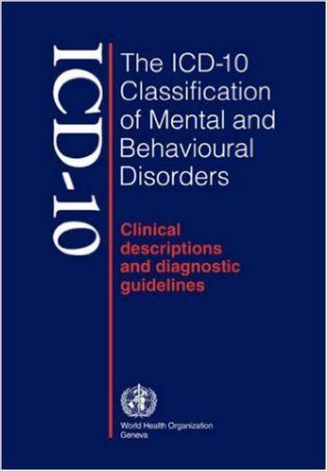
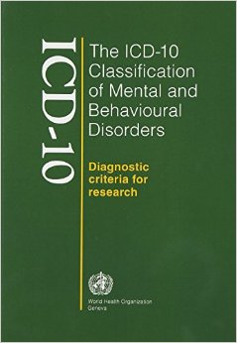
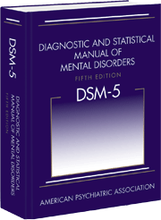
Schizophrenia in Diagnostic Manuals
DSM-IV, Diagnostic and Statistical Manual of Mental Disorders, 4th Edition¹
WHO. ICD-10 Classification of Mental and Behavioral Disorders 1993²
DSM-5, Diagnostic and Statistical Manual of Mental Disorders, 5th Edition³
(1) American Psychiatric Association. Diagnostic and statistical manual of mental disorders: DSM-IV. 4th edition: American Psychiatric Association. 1994:866; (2) WHO. ICD-10 Classification .1993. Available from: http://www.who.int/classifications/icd/en/GRNBOOK.pdf. Accessed April 2016; (3) American Psychiatric Association. Diagnostic and statistical manual of mental disorders 5th edition: American Psychiatric Association. 2013
Notes:
Major manuals used for the diagnosis of schizophrenia:
American Psychiatric Association. Diagnostic and statistical manual of mental disorders: DSM-IV. 4th edition: American Psychiatric Association. 1994:866;
WHO. ICD-10 Classification .1993. Available from: http://www.who.int/classifications/icd/en/GRNBOOK.pdf. Accessed April 2016;
American Psychiatric Association. Diagnostic and statistical manual of mental disorders 5th edition: American Psychiatric Association. 2013

Slide 24
DSM-5 Diagnostic Criteria for Schizophrenia
Criteria
A: 2 (or more) of the following, each present for a significant portion of time during a 1-month period (or less if successfully treated). At least one of these must be 1-3
Delusions
Hallucinations
Disorganized speech (eg, frequent derailment or incoherence)
Grossly disorganized or catatonic behavior
Negative symptoms (ie, diminished emotional expression or avolition)
B: For a significant portion of time since the onset of the disturbance, level of functioning in 1 or more major areas, such as work, interpersonal relations, or self-care, is markedly below level achieved prior to the onset (or when the onset is in childhood or adolescence, there is failure to achieve expected level of interpersonal, academic, or occupational functioning
C: Continuous signs of the disturbance persist for at least 6 months. This 6-month period must include at least 1 month of symptoms (or less if successfully treated) that meet Criterion A (ie, active-phase symptoms) and may include periods of prodromal or residual symptoms. During these prodromal or residual periods, the signs of the disturbance may be manifested by only negative symptoms or by 2 or more symptoms listed in Criterion A present in attenuated form (eg, odd beliefs, unusual perceptual experiences)
DSM-5=Diagnostic and Statistical Manual of Mental Disorders. Fifth Edition.
American Psychiatric Association. Diagnostic and Statistical Manual of Mental Disorders. Fifth Edition. Arlington, VA: American Psychiatric Association; 2013
Notes:
Review as stated on slide

Slide 25
DSM-5 Diagnostic Criteria for Schizophrenia (cont’d)
D: Schizoaffective and depressive or bipolar disorder with psychotic features have been ruled out because either:
No major depressive or manic episodes have occurred concurrently with the active-phase symptoms
If mood episodes have occurred during active-phase symptoms, they have been present for a minority of the total duration of the active and residual periods of the illness
E: The disturbance is not attributable to the physiological effects of a substance (eg, a drug of abuse, a medication) or another medical condition
F: If there is a history of autism spectrum disorder or a communication disorder of childhood onset, the additional diagnosis of schizophrenia is made only if prominent delusions or hallucinations, in addition to the other required symptoms of schizophrenia, are also present for at least 1 month (or less if successfully treated)
Specifier
Course- to be used after 1 year duration of the disorder
First episode, currently in acute episode/partial remission/full remission
Multiple episodes, currently in acute episode/partial remission/full remission
Continuous
Unspecific
DSM-5=Diagnostic and Statistical Manual of Mental Disorders. Fifth Edition.
American Psychiatric Association. Diagnostic and Statistical Manual of Mental Disorders. Fifth Edition. Arlington, VA: American Psychiatric Association; 2013
Notes:
Review as stated on slide

Slide 26
Differences between DSM IV and DSM 5

Slide 27
DSM IV
DSM 5
Schizophrenia and other psychotic disorders
Schizophrenia spectrum and other psychotic disorders

Slide 28
Organization of disorders
DSM IV
DSM IV
DSM 5
Grouped together based on Psychotic symptoms
as prominent aspect of presentation
as associated features excluded
Psychotic symptoms- not a core or fundamental feature
Disorders do not have a common etiology
Organized along gradient of psychopathology
Disorders not meeting full criteria or limited to one domain
Time limited conditions (catatonia and delusional disorders)
Need to exclude other conditions of psychosis
Schizophrenia spectrum

Slide 29
Definitions
DSM IV
DSM 5
Psychosis defined differently for different disorders
Schizophrenia, schizophreniform disorder, schizoaffective disorder and brief psychotic disorder-
Delusions, hallucinations, disorganized speech, or disorganized or catatonic behavior.
Psychotic disorder due to general medical condition and substance induced psychotic disorder-
Delusions or hallucinations with no insight.
Delusional disorder-
Delusions
Common definition of psychosis; includes
Delusions
Hallucinations
Disorganized thinking (speech)
Grossly disorganized or abnormal motor behavior (including catatonia)
Negative symptoms

Slide 30
Definitions
DSM IV
DSM 5
Negative symptoms- 3 symptoms-
affective flattening, avolition and alogia (anhedonia included in associated features and disorders)
Catatonia
subtype of schizophrenia
specifier in other disorders
Negative symptoms- 2 symptoms-
decreased emotional expression and avolition(anhedonia, alogia and asociality included in associated features)
Catatonia- separated diagnosis

Slide 31
Disorders included
DSM IV
DSM 5
Schizophrenia
Schizophreniform disorder
Schizoaffective disorder
Delusional disorder
Brief psychotic disorder
Shared psychotic disorder (excluded)
Psychotic disorder due to general medical condition
Substance induced psychotic disorder
Psychotic disorder Not Otherwise Specified (excluded)
Schizotypal disorder
Delusional disorder
Brief psychotic disorder
Schizophreniform disorder
Schizophrenia
Schizoaffective disorder
Psychotic disorders induced by another condition
Substance induced
Due to general medical condition
Catatonia
Other specified and unspecified schizophrenia spectrum and other psychotic disorders

Slide 32
Differences – Schizophrenia
DSM IV
DSM 5
If delusions are bizarre or hallucinations consists of a voice giving a running commentary or two or more voices conversing with each other, sufficient to qualify for schizophrenia diagnosis
Two or more psychotic symptoms are needed
Bizarre delusions and first rank symptoms excluded as a criteria for schizophrenia

Slide 33
Differences – Schizophrenia
DSM IV
DSM 5
Subtypes: based upon the symptom that dominates the most recent evaluation and may change over time
Catatonic type
Disorganized type
Paranoid type
Undifferentiated type
Residual type
Subtypes have been excluded

Slide 34
Differences – Schizophrenia
DSM IV
DSM 5
Course- Longitudinal phase
Episodic
With/Without interepisode residual symptoms
Continuous
Single episode
in partial/full remission
Other or unspecified pattern
Course- Longitudinal phase
First episode (Previously single episode)
currently in acute episode/partial or full remission
Multiple episodes (Previously episodic)
currently in acute episode/partial or full remission
Continuous
Unspecified

Slide 35
Differences – Schizophrenia
DSM IV
DSM 5
Prevalence is in the range of 0.5- 1.5 %
Decrease in reporting of prevalence - 0.3 - 0.7 %
Severity assessment for psychotic symptoms, mood symptoms, abnormal psychomotor behavior & negative symptoms and cognitive symptoms

Slide 36
Differences – Delusional disorder
DSM IV
DSM 5
1 month or longer NON- bizarre delusions
Prevalence in the range of 1-2%
1 month or longer Delusions; “Non-bizarre” removed from criteria
Lifetime prevalence is 0.2%

Slide 37
Differences – Delusional disorder
DSM IV
DSM 5
Erotomanic delusions- idealized romantic and spiritual union rather than sexual attraction with a person of higher status
No major changes in criteria
Course specifier similar to schizophrenia
Severity specifier similar to other psychotic disorders

Slide 38
Differences – Brief psychotic disorder
DSM IV
DSM 5
Prevalence was thought to be rare in US
No mention of any risk or prognostic factors
Catatonia specifier added
Severity specifier added
Prevalence is high and around 9%
Risk and prognostic factors:
Temperamental factors psychoticism domain traits
High rates of relapse; but good prognostic value

Slide 39
Differences – schizoaffective disorder
DSM IV
DSM 5
Requires the assessment of mood symptoms only for the current period of illness
No information on prevalence
Requires the assessment of mood symptoms for the entire course of a psychotic illness
Prevalence is 0.3%

Slide 40
Differences – Schizophreniform disorder
DSM IV
DSM 5
Specifiers included
Without good prognostic features
Confusion or perplexity at the height of the psychotic episode
Specifiers included
Without good prognostic features
Confusion or perplexity – no mention of temporal correlation
Catatonia
Severity

Slide 41
Differences – Substance/medication – Induced psychotic disorder
DSM IV
DSM 5
Change in symptom appearance in criterion B
Evidence of either 1 or 2
Symptoms in criterion A developed during or within a month of, substance intoxication or withdrawal
Medication use is etiologically related to the disturbance
Changes as follows
Evidence of both 1 & 2
Symptoms in criterion A developed soon after substance intoxication or withdrawal or after exposure to a medication
The involved substance is capable of producing the symptoms in “A”

Slide 42
Differences – Substance/medication – Induced psychotic disorder
DSM IV
DSM 5
No mention of effects on functioning
Specifiers:
Predominant symptoms presentation
With delusions
With hallucinations
No mention of severity specifier
No mention about prevalence
Clinically significant distress or impairment in social, occupational or other important areas of functioning is added to criteria
Specifiers:
No mention of predominant individual symptoms
Severity specifier included
Prevalence is around 7—25%

Slide 43
Differences – Substance/medication – Induced psychotic disorder
DSM IV
DSM 5
No mention of effects on functioning
Specifiers include
Predominant symptoms presentation
No mention of severity
Prevalence is not mentioned
No major changes in criteria
Clinically significant distress or impairment in social, occupational or other important areas of functioning is added to criteria
Specifiers include
Predominant symptoms presentation
Severity
Lifetime prevalence is about 0.21 to 0.54%

Slide 44
Differences – Catatonia
DSM IV
DSM 5
Is a subtype of schizophrenia and also specifier in mood disorders, and medication induced disorders
Is a specifier/ associated condition

Slide 45
Differences – Psychotic disorder not otherwise specified
DSM IV
DSM 5
Psychotic disorder not otherwise specified
Inadequate or contradictory information to make a specific diagnosis
Do not meet the criteria for any specific psychotic disorder
Unspecified schizophrenia spectrum and other psychotic disorder 298.9 (F29)
Clinically significant distress or impairment in social, occupational or other important areas of functioning predominate but do not meet full criteria for any of the disorders

Slide 46
Differences – Other disorders
DSM IV
DSM 5
Shared psychotic disorder (Folie a Deux) is a separate entity
Other specified schizophrenia spectrum and other psychotic disorder 298.8 (F28)
Symptoms characteristic of a schizophrenia spectrum and other psychotic disorder that cause clinically significant distress
Does not meet full criteria for any of the disorders in the spectrum

Slide 47
Differences – Other disorders
DSM IV
DSM 5
No such classification present
Includes:
Persistent auditory hallucinations in the absence of any other features
Delusions with significant overlapping mood episodes
Attenuated psychosis syndrome: psychotic- like symptoms below a threshold for full psychosis
Delusional symptoms in partner of individual with delusional disorder

Slide 48
Summary
Change in the organization/arrangement of disorders
Changes in the definition of the term “psychosis” and its application is common to all the disorders listed
Changes in the disorders
Inclusion of Schizotypal disorder, catatonia and other unspecified disorders
Exclusion of Shared Psychotic disorder and Psychotic disorder NOS
Exclusion of bizarre delusions and voices commenting or conversing with each other from the inclusion criteria of schizophrenia
Exclusion of subtypes of schizophrenia
Exclusion of non-bizarre delusions from criteria for diagnosing delusional disorder
Requirement that mood symptoms be a part of “total duration” of psychotic illness rather than only for the “current episode” of psychotic illness
Inclusion of catatonia as a separate disorder

Slide 49
Differences between DSM 5 and IC10

Slide 50
DSM 5
ICD 10
Schizophrenia spectrum and other psychotic disorders
Schizophrenia, schizotypal and delusional disorders

Slide 51
Disorders included
DSM 5
ICD 10
Schizotypal disorder
Brief psychotic disorder
Delusional disorder
Schizophreniform disorder
Schizophrenia
Schizoaffective disorder
Psychotic disorders induced by another condition
Substance induced
Due to general medical condition
Catatonia
Other specified and unspecified schizophrenia spectrum and other psychotic disorders
Schizophrenia F20
Schizotypal disorder F21
Persistent delusional disorder F22
Acute and transient psychotic disorder F23
Induced delusional disorder F24
Schizoaffective disorder F25
Other non-organic psychotic disorder F28
Unspecified non-organic psychotic disorder F29

Slide 52
Differences – Schizophrenia
DSM 5
ICD 10
First rank symptoms excluded
Includes First Rank Symptoms
Thought echo, insertion or withdrawal, broadcasting, delusions of control, influence or passivity, delusional perception, hallucinatory voices (commenting or discussing the patient with each other), persistent delusions, daily (culturally inappropriate and completely impossible)

Slide 53
Differences – Schizophrenia
DSM 5
ICD 10
Duration of illness is 6 months
Impairment in level of functioning is one of the criteria
Duration of illness is 1 month or more (except for simple schizophrenia)
No mention of functioning

Slide 54
Differences – Schizophrenia
DSM 5
ICD 10
Subtypes excluded
Subtype present
F20.0: paranoid schizophrenia
F20.1: hebephrenic schizophrenia
F20.2: catatonic schizophrenia
F20.3: undifferentiated schizophrenia
F20.4: post-schizophrenia depression
F20.5: residual schizophrenia
F20.6: simple schizophrenia
F20.8: other schizophrenia
F20.9: schizophrenia, unspecified

Slide 55
Differences – Schizophrenia
DSM 5
ICD 10
Course specifier- to be used after 1 year duration of the disorder
First episode, currently in partial remission/full remission
Multiple episodes, currently in acute episode/partial remission/full remission
Continuous
Unspecified
Course specifier
Continuous
Episodic with progressive deficit/stable deficit
Episodic remittent
Incomplete remission/complete remission
Other
Course uncertain, period of observation too short

Slide 56
Differences – Schizophrenia
DSM 5
ICD 10
Course specifier
Catatonia
Severity
Catatonic schizophrenia is a subtype
No course specifier for severity

Slide 57
Differences – Persistent delusional disorder
DSM 5
ICD 10
One (or more) delusions of 1 month or longer
Relatively brief manic or major depressive episodes to the duration of delusional periods
Delusions for at least 3 months
Depressive symptoms or a full blown depressive episode may be present, provided that the delusions persist at times when there is no disturbance of mood

Slide 58
Differences – Persistent delusional disorder
DSM 5
ICD 10
Specifier
Types
Erotomanic
Grandiose
Jealous
Persecutory
Somatic
Mixed
unspecified
F22: persistent delusional disorders
F22.0: delusional disorder
F22.8: other persistent delusional disorders
F22.9: persistent delusional disorder, unspecified

Slide 59
Differences – Acute and transient psychotic disorders
DSM 5
ICD 10
Brief psychotic disorder
Duration between 1 day and 1 month
Acute and transient psychotic disorders- 1 month
F23.0: acute polymorphic psychotic disorder without symptoms of schizophrenia
F23.1: acute polymorphic psychotic disorder with symptoms of schizophrenia
F23.2: acute schizophrenia-like psychotic disorder
F23.3: other acute predominantly delusional psychotic disorder
F23.8: other acute and transient psychotic disorders
F23.9: acute and transient psychotic disorder, unspecified

Slide 60
Differences – Persistent delusional disorder
DSM 5
ICD 10
Specifier
Course- to be used after 1 year duration of the disorder
First episode, currently in acute episode
First episode, currently in partial remission
First episode, currently in full remission
Multiple episodes, currently in acute episode
Multiple episodes, currently in partial remission
Multiple episodes, currently in full remission
Continuous
Unspecified
None present

Slide 61
Differences – Acute and transient psychotic disorders
DSM 5
ICD 10
Specifier
Brief reactive psychosis- with marked stressor(s)
Without marked stressor(s)
With postpartum onset: onset during pregnancy or within 4 weeks postpartum
With catatonia
Severity
Specifier
F23.x0: without associated acute stress
F23.x1: with associated acute stress
Postpartum disorders included in F53

Slide 62
Differences – Schizophreniform disorder
DSM 5
ICD 10
Same criteria as schizophrenia with duration of illness between 1 month but less than 6 months
Not included as criteria for diagnosis of schizophrenia is 1 month

Slide 63
Differences – Schizoaffective disorder
DSM 5
ICD 10
Criteria for mood disorders and criteria for schizophrenia is met
Total duration for schizophrenia is met (6 months)
The total longitudinal duration of the illness is considered rather than the episode duration
Criteria for mood disorders is met
Criteria for schizophrenia is met within the same episode of the disorder or concurrently for at least part of the disorder
Inclusion on first rank symptoms as for with schizophrenia

Slide 64
Differences – Induced delusional disorder
DSM 5
ICD 10
Included under Other specified schizophrenia spectrum and other psychotic disorder 298.8
Delusional symptoms in partner of individual with delusional disorder
Included as Shared psychotic disorder included in DSM IV
Two or more people share the same delusion or delusional system
Have an unusually close relationship
Temporal or other contextual evidence of the delusion being induced in the passive member

Slide 65
Differences – Other nonorganic psychotic disorders
DSM 5
ICD 10
Includes:
Persistent auditory hallucinations in the absence of any other features
Delusions with significant overlapping mood episodes
Attenuated psychosis syndrome: psychotic- like symptoms below a threshold for full psychosis
Delusional symptoms in partner of individual with delusional disorder
Includes: chronic hallucinatory psychosis NOS

Slide 66
Differences – Unspecified psychosis
DSM 5
ICD 10
Unspecified schizophrenia spectrum and other psychotic disorder 298.9
Unspecified nonorganic psychosis
Includes Psychosis NOS

Slide 67
Summary
DSM 5 includes schizotypal disorder similar to the current ICD 10 (In DSM IV, it was included in personality disorders)
IN DSM 5 duration for diagnosing schizophrenia is 6 months while in ICD 10 it is 1 month
DSM 5 does not include First Rank Symptoms for diagnosing schizophrenia
DSM 5 includes functioning as a criterion for diagnosing schizophrenia while no mention of functioning is seen in ICD 10
In DSM 5 schizophrenia subtypes have been eliminated
DSM 5 includes schizophreniform disorder as a separate diagnosis while ICD does not have this as a separate diagnosis
The duration for diagnosing delusional disorder in DSM 5 is 1 month while it is 3 months in ICD 10
DSM 5 includes a diagnosis of Brief Psychotic disorder while its comparable alternative in the ICD 10 is Acute and transient Psychotic disorders
In DSM 5 the presence of mood symptoms in schizoaffective disorder is required for the total duration of psychotic episode while in ICD 10, the current psychotic episode is considered.
DSM includes shared psychotic disorder in Other disorders while it is given a separate listing as Induced Delusional disorder in ICD 10

